Slide 1

Keys to Becoming a Billionaire
How the data behind billionaires illuminates the path to success
Elias Hairatidis, Sofia Huang, and Samariddin Zarifov

Slide 2
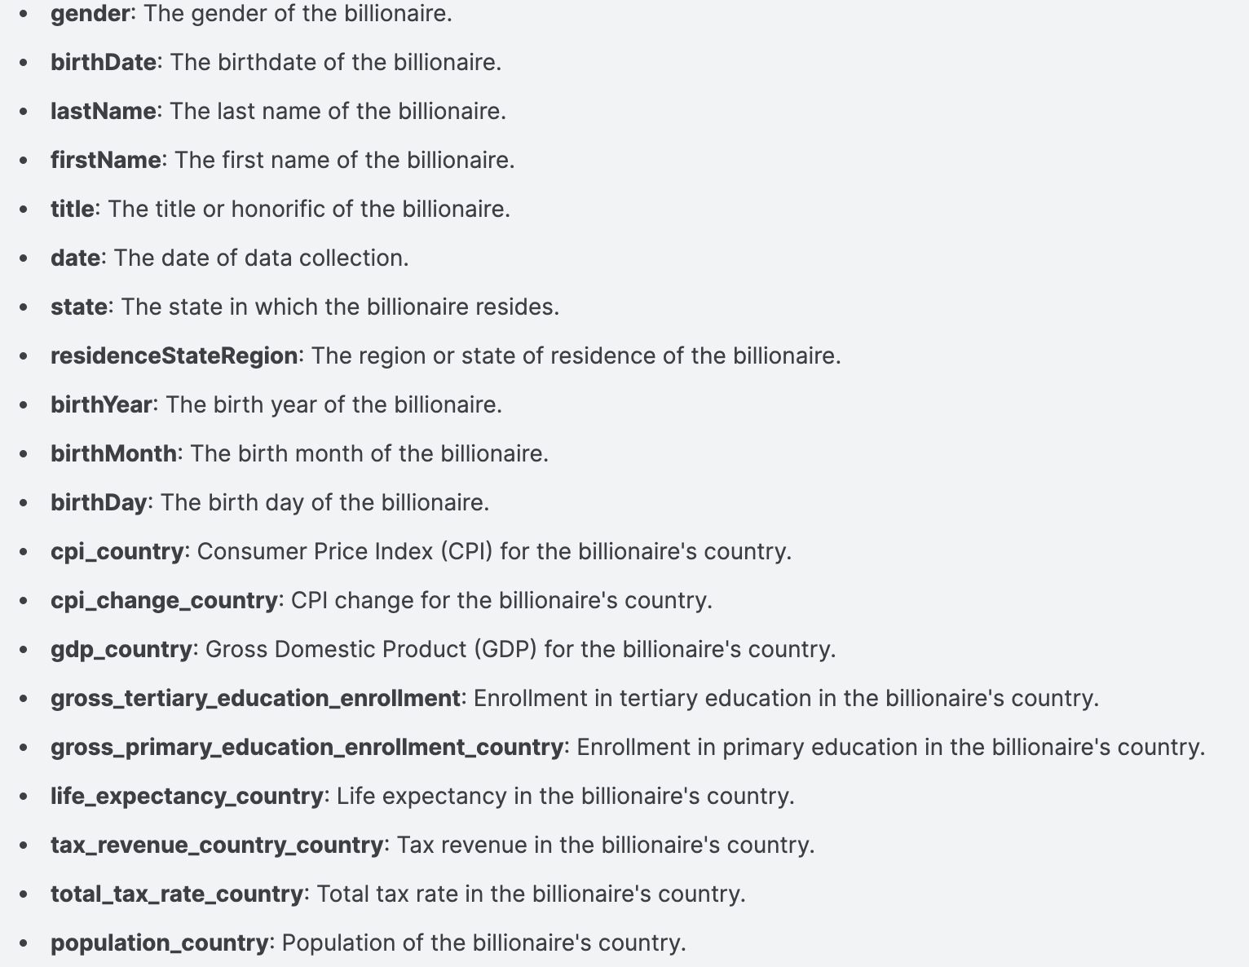
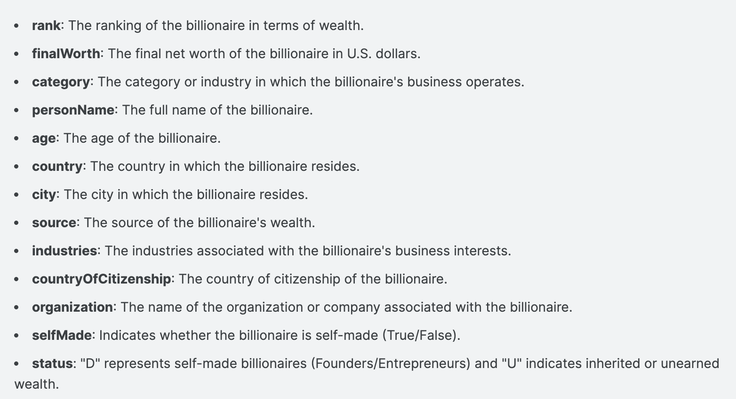
Introduction to our Data
"Delve into the opulent world of billionaires with our comprehensive dataset. Discover the intricate details of their wealth, from industries and sources to demographics and geographic locations. Explore the fascinating realm of billionaire statistics and unearth insights into the elite few who have reached the pinnacle of success.”
- NIDULA ELGIRIYEWITHANA

Slide 3

Thesis: By highlighting the distribution of billionaires, showcasing their diverse backgrounds, and emphasizing the importance of being a self-starter, we aim to inspire and inform our audience about the pathways to success.

Slide 4

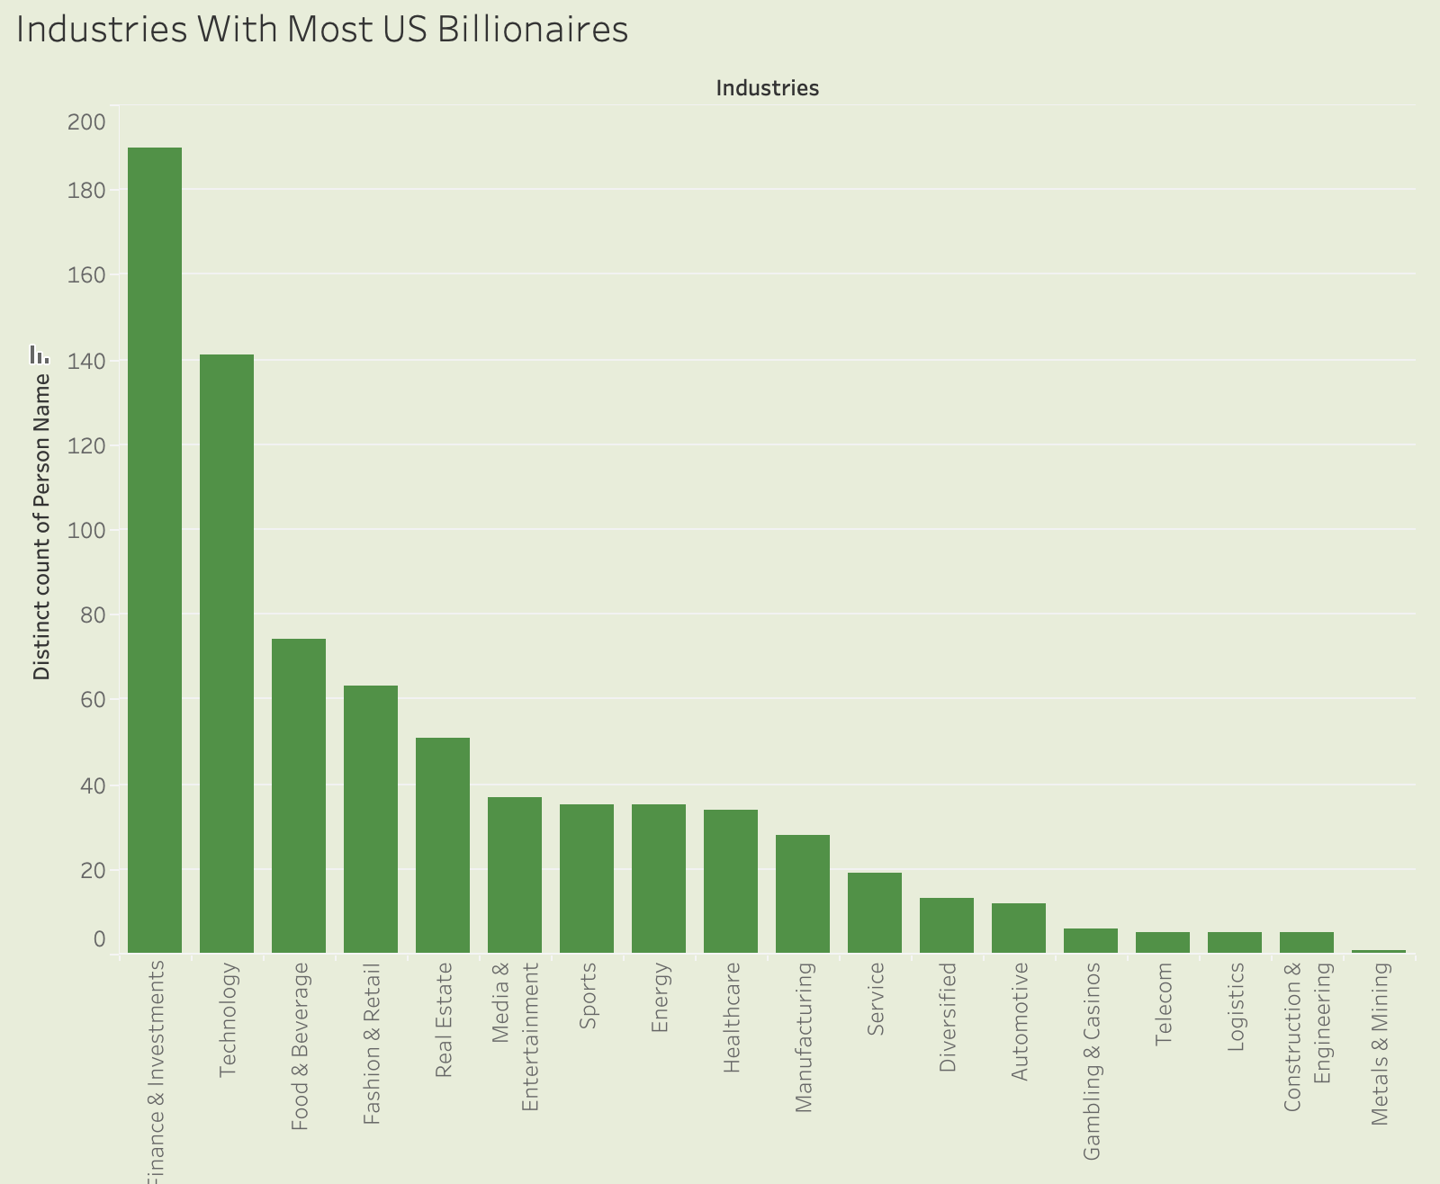
Target Audience: Our dashboards are designed for potential business students, aspiring self-starters, and managers who are keen on understanding the qualities inherent in successful individuals and applying these insights in their own journeys.

Slide 5

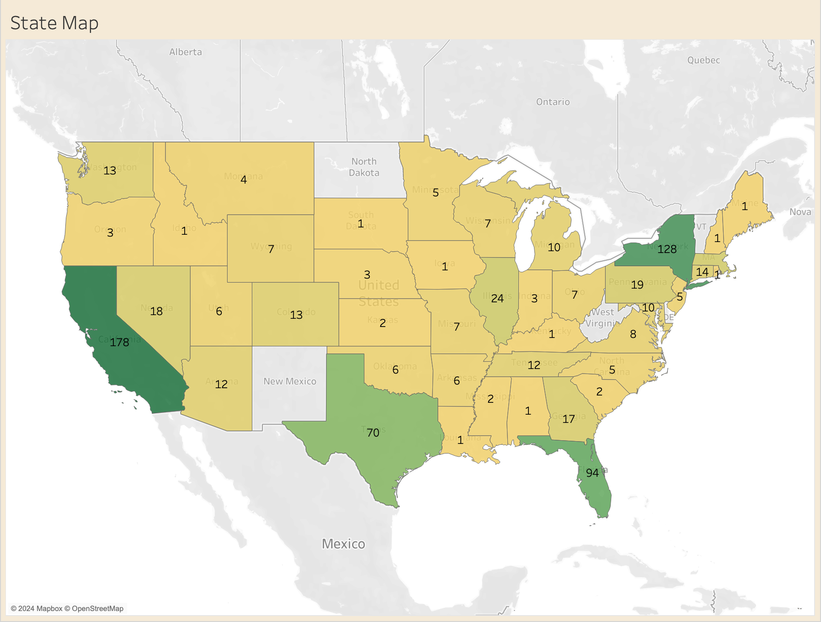
Goal: The primary objective of our presentation is to highlight the distribution of billionaires, showcase their diverse backgrounds, and exemplify the need for becoming a self-starter. We aim to transform complex data into intuitive visual narratives that reveal patterns and trends in global wealth.

Slide 6

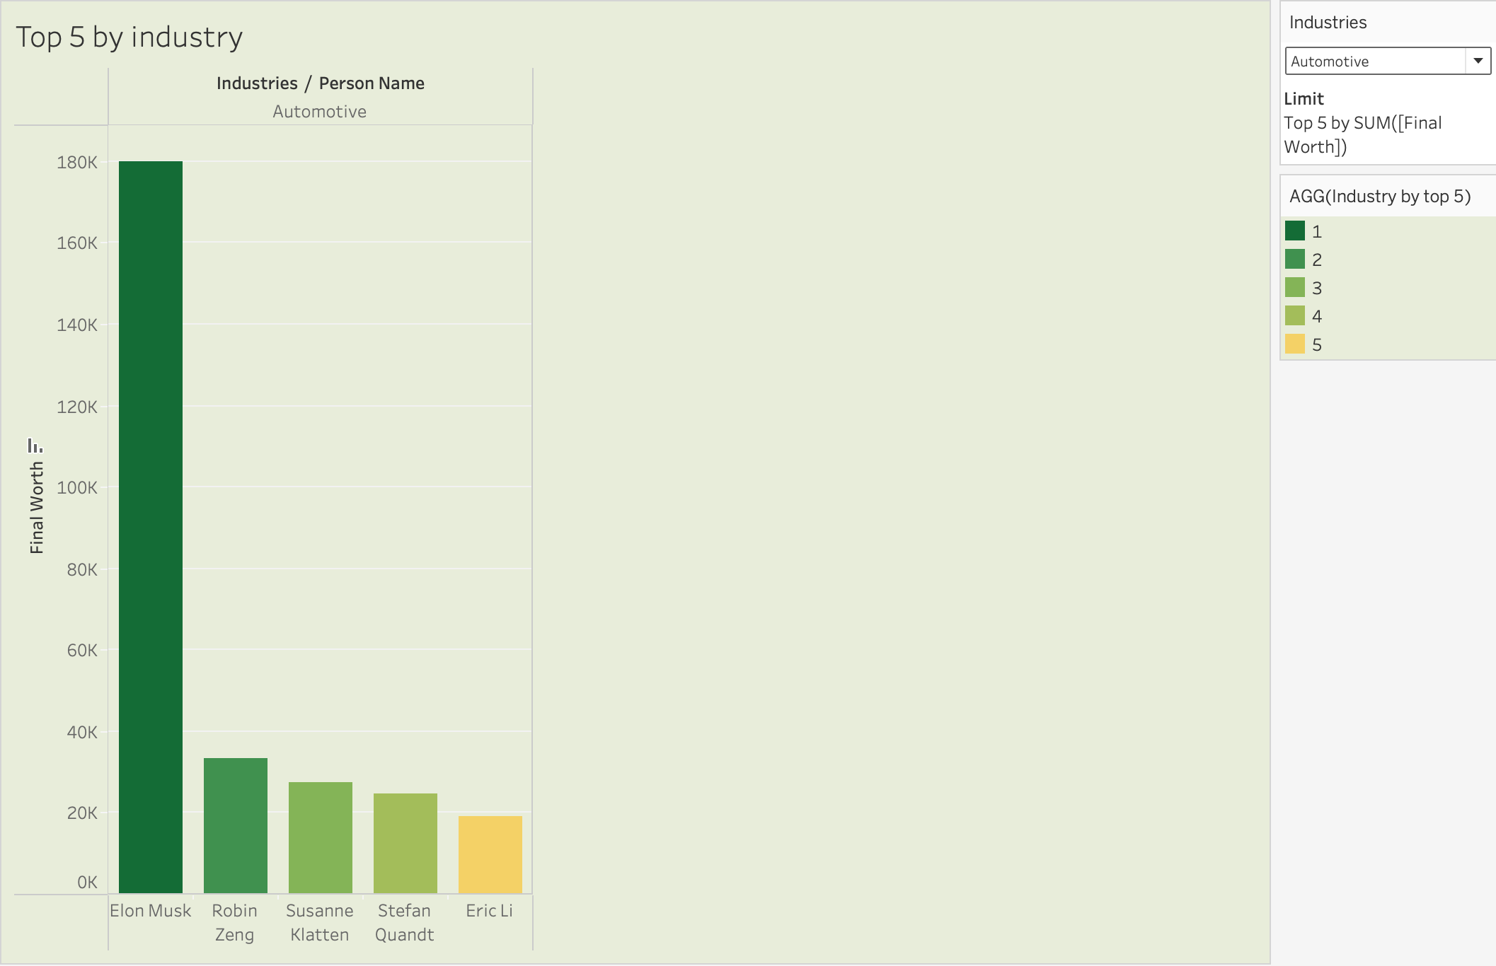
Moral Point: Our dashboards underscore the moral that success is often the result of being a self-starter. By studying the characteristics and backgrounds of billionaires, our audience can gain valuable insights into the qualities that contribute to extraordinary success.

